Slide 1
Oracle Character Group
Week 1+2 Outcome Review

Slide 2
Learning Outcomes

Slide 3
1. Deep Learning Course from NTU
Prograss: 50% of all courses
Content:
Introduction
Neural Network Basics
Backpropagation
Word Representation
Sequence Modeling
RNN
RvNN
Word Embedding

Slide 4
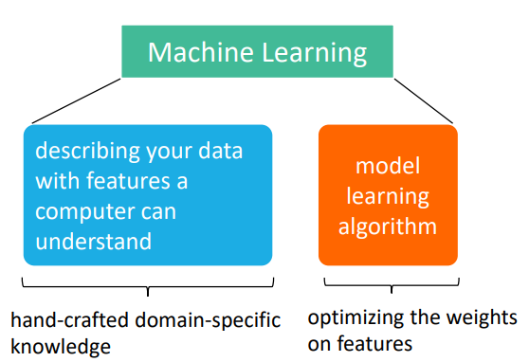
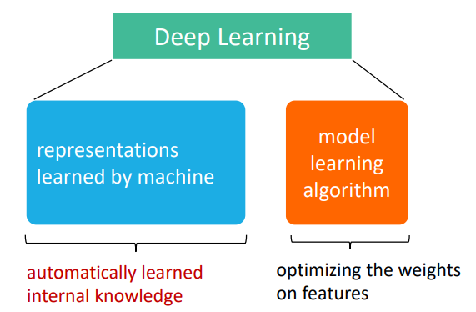
Introduction
Machine learning v.s. Deep Learning
Deep Learning v.s. Neural Network:
DL is usually refers to neural network based model.
Deeper NN is better for more parameters
Notes:
<number>

Slide 5
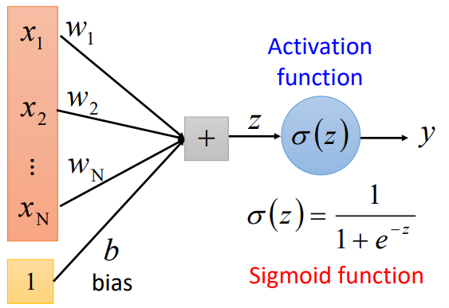
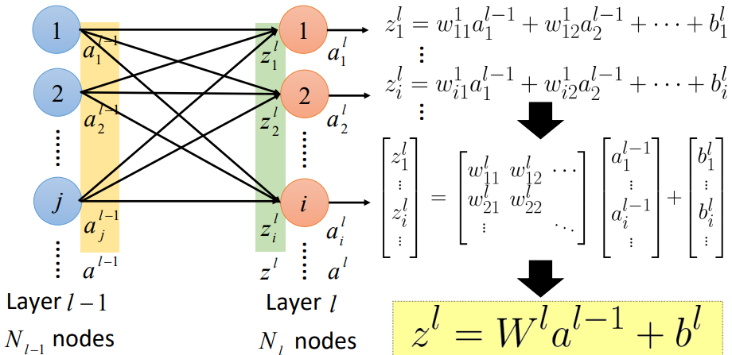
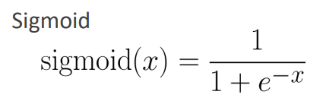

Neural Network
1. Model Architecture
Learn-Function: f(x)=y
x: N dim y: M dim
A Single Neuron Structure (Figure.1)
A layer of nuerons. Cannot handle complex division → Multi-Layer NN
Layer Relation Representation (Figure.2)
Use non-linear Activation Function because muti-layer linear function
Works as one. The frequently used one is:
figure.1
figure.2

Slide 6
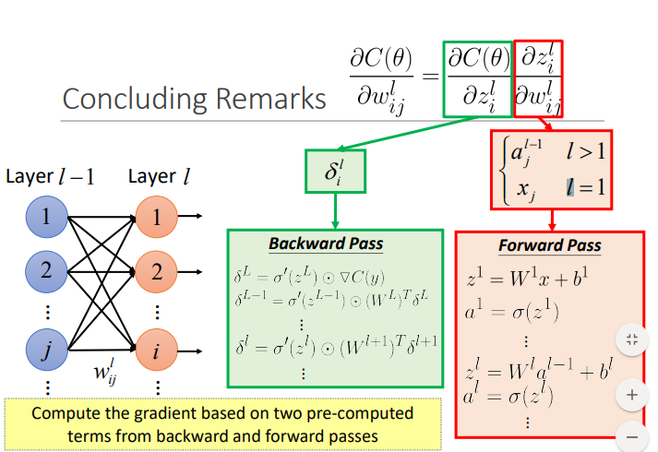
Backpropagation
Formula：

Slide 7
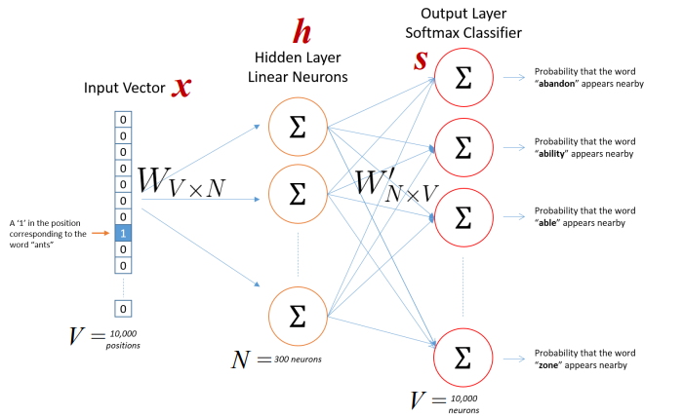
Word Embedding
Word2Vec
1. Skip-gram
Given a word, and then maxmize the probability of context word
The hidden layer is the vector representation of the word
2. CBOW (continuous bag-of-words)
Predict the word given the context
3. LM(Language Model)
Predicting the next word given the proceeding words
Glove
1. Count-based + Direct prediction
2. Use the ratio of co-occurrence probability to predict p of the word appearing in the context of another word
Evaluation
Word Analog (Use the linear relation to represent similarity)
Human-judged word correlation
Subsequent Task

Slide 8
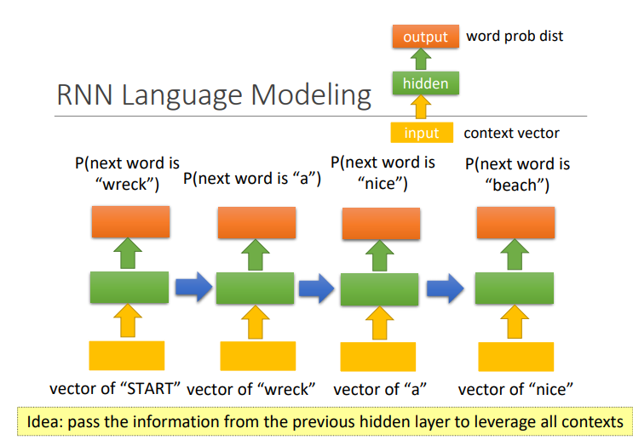
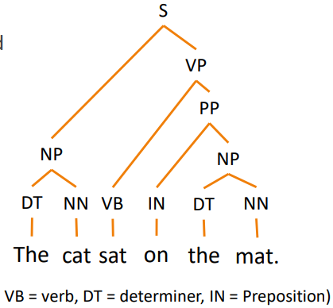
Sequence Modeling
Convolutional neural(CNN) →image
Recurrent neural network(RNN) →The order of words (temporal information matters) →GD easy to get very big/small (figure.1)
Recursive Neural Network(RvNN) →The combination of words →Parsing tree(figure.2)
Figure.1
Figure.2
Notes:
<number>

Slide 9
2. Tensorflow
Prograss: 43% of all courses + almost all related software installed
Overall:
- Mainly based on the book "Hands-On Machine Learning with Scikit-Learn & TensorFlow" and videos series entitled "Tensorflow 搭建自己的神经网络 (莫烦 Python 教程) "
- Contents: Introduction (p2), Graph (p3), Session, Variable & Placeholder (p4), Actication Function & Optimiser (p5)

Slide 10
Introduction
TensorFlow is a powerful open source software library for numerical computation, particularly well suited and fine-tuned for large-scale machin learning.- Advantages over other ML / DL libraries:
1. Ran on Multiple platforms- Also on mobile devices, including both iOS and Android
2. Compatible with Scikit-Learn
3. Automatic differentiating (or autodiff)- Used to search for the parameters that minimize a cost function
4. Huge community support
Graph
Data flow graphs use directional graphs with nodes and edges to describe mathematical computation.
Nodes: represent mathematical operations
- Also they can be treated as *feeding-in* / *pushing-out* of data or *persistent variable*
Edges: represent relationships between nodes
- It can transfer multiple-demensional arrays with variable size, i.e *tensor*
- This is why the toolkit is called TensorFlow ;)

Slide 11
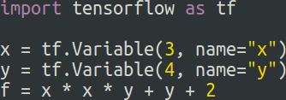

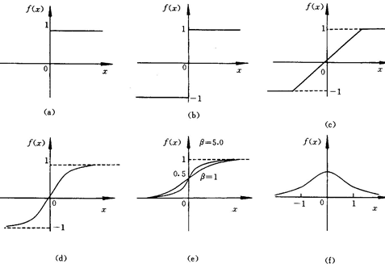
Variable, Session & Placeholder
A typical TensorFlow program consists of two parts:
- Build a computation graph representing ML model (construction phase)
Run the session containing a loop that evaluates a training step repeatedly (execution phase); TensorFlow session takes care of placing the operations. (Figure. 2)
Placeholder is to describe waiting-for-input nodes and hold these values.
- Only their types are assigned directly; execute by feeding a dictionary to these nodes.
`placeholder` and `feed_dict` usually appear together.
Actication Function & Optimiser
Popular activation functions are showed below: (Figure.3)
TensorFlow also provides a number of optimizers out of the box,
including a Gradient Descent optimizer.
- Single-line code to implement Gradient Descent algorithm
Figure.1
Figure.2
Figure.3

Slide 12
Data Outcomes

Slide 13
1. Overall
Source:
http://hanziyuan.net get the using permission from the website
http://xiaoxue.iis.sinica.edu.tw/ (Still working on it)
Oracle characters+Bronze characters+Liushutong characters (Still running)
Characters with Oracle characters:(964) and their oracle characters: (86689)

Slide 14
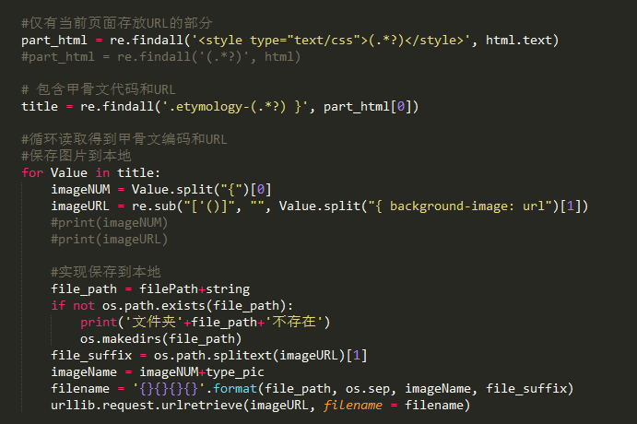
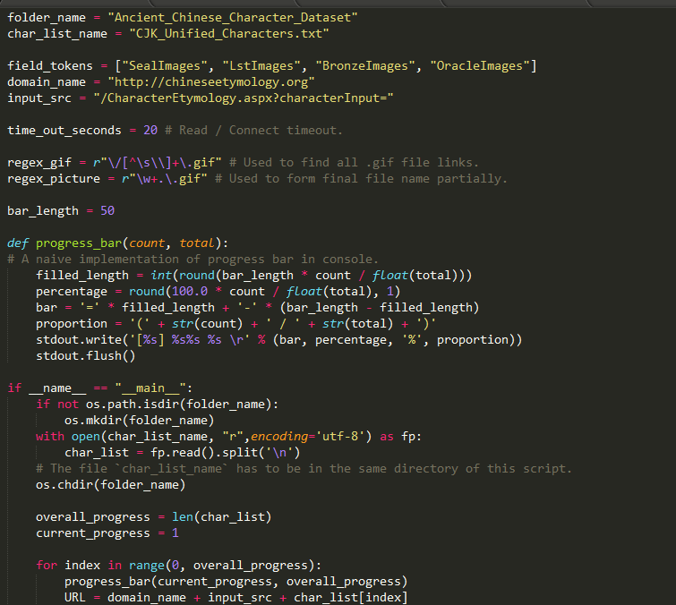
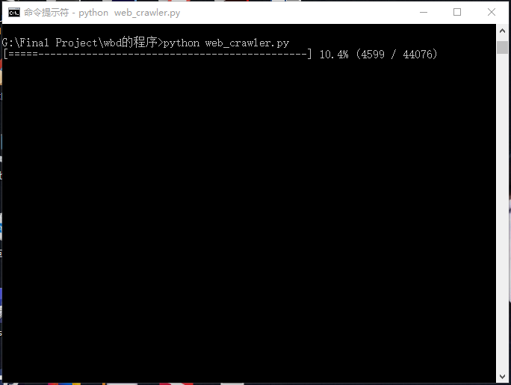
2. Crawlers Codes
Use Requests to imitate the search progress using ‘Post’
Get the responding code dynamically when each searching
Get the urls of pictures from the responding code, download them and save them

Slide 15
Others

Slide 16
Questions
We are going to use certain fraction of the picture we have got to learn and use the renaming ones to test as unknown oracle character pictures. Besides, we are going to draw some oracle characters based on the pictures we got to test the learning outcome. Is it reasonable and what do you think is suitable?
Is it suitable for us to present our outcomes using ’Web’?
We do not have deep understanding regarding this area. So could you please help us to plan the project and set some mile stones on certain days?
The paper’s requests are unclear. Are we required to write absolutely different contents in the individual paper?

